Slide 1

Design Pattern
Builder

Slide 2
Builder
Type
Object Creational

Slide 3
Builder
Intent
The Builder Pattern separates the construction of a complex object from its representation so that the same construction process can create different representations.

Slide 4
Builder
Solution
  Simplify the construction of complex objects by only specifying the type and content that the object requires.
  Allows different representations of the complex object to be created by the different builders.
  Each of the concrete builder objects will construct a different representation of the complex object.

Slide 5
Builder
The Builder Pattern consists of:
  Director object is responsible for the construction process of the complex object but delegates the actual creation and assembly to the Builder interface.
  The Builder object specifies the interface for creating parts of the complex object.
  The ConcreteBuilder (1 or more) objects create and assemble the parts that make up the Product through the Builder interface.
  The Product represents the complex object that is created by the ConcreteBuilder objects. The Product consists of multiple parts that are created separately by the ConcreteBuilder objects.

Slide 6
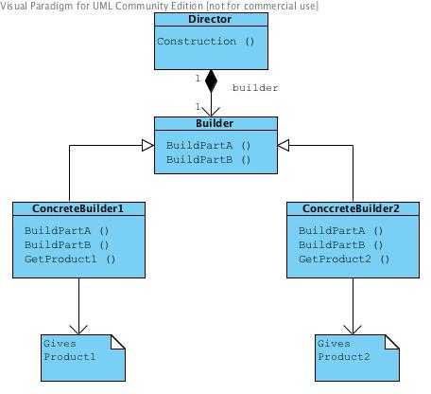
Builder

Slide 7
Builder
Example
  A meal at a fast food franchises.
  The complex Product is a combo meal that consists of
    A burger
    A beverage
    A side order.

Slide 8
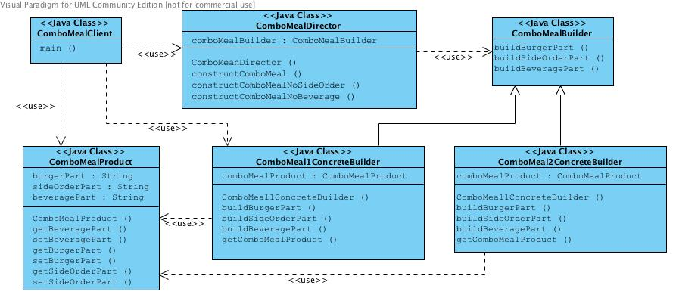
Builder

Slide 9
Builder
ComboMealDirector.java
public void constructComboMeal(SuperSize mealSize) {
comboMealBuilder.buildBurgerPart();
comboMealBuilder.buildSideOrderPart(mealSize);
comboMealBuilder.buildBeveragePart(mealSize);
} // method constructComboMeal

